Slide 1
Dictionary
An abstract data structure which stores data in the form of key-value(k,v) pairs.
A key is associated with a value
Also called as “Maps” ,”Associative Arrays”.
Eg : Consider a Data structure that stores Bank accounts , it can be viewed as a dictionary ,where account number serves as a key for identification of account objects
Restrictions :
Every key can appear only “once” within the dictionary
Each key can have “one value”
But , there can be duplicate of value within a dictionary .
(Like Paul,is repeated ,but it has different keys )
Key | Value
11 | John
12 | Paul
13 | Smith
14 | Paul

Slide 2
Dictionary continued..
Different data structures to realize dictionaries
Arrays,Linked lists (inefficient)
Hash Table
Binary Trees
Red/Black trees
AVL trees
B-Trees
In Java :
java.util.Dictionary-abstract class
java.util.Map - interface

Slide 3
ID | Name
352123 | John
34654 | Paul
12312 | Smith
12534 | Paul
Dictonary using
Hash Table :
Hash Function
Index | Value
1 | John
2
3 | Paul
4 | Smith
5
6 | paul

Slide 4
Implementation
Binary search tree
Hash table
Data is stored in stored in storted order i.e inorder traversal will give the sorted order
There is no need of hash function in BST
Collision doesn’t occur in BST
Input data size need not to be known in advance
Time complexity : 0(logn)
Searching / Traversing takes time
Data is stored randomly , to store in sorted order it requires extra variable
A hash function is needed to generate a key and to perform opertions within o(1)time.
If collisions occur ,chaining and open addressing is used
Input Data size should be pre-defined before using hash table
Time complexity : o(1)
Searching / Traversing is fast

Slide 5
Operations on dictionary:
Determine whether dictionary is empty is not.
Determine the dictionary size.
Find the pair with specific key.
Insert pair into the dictionary.
Delete the pair from dictionary.

Slide 6
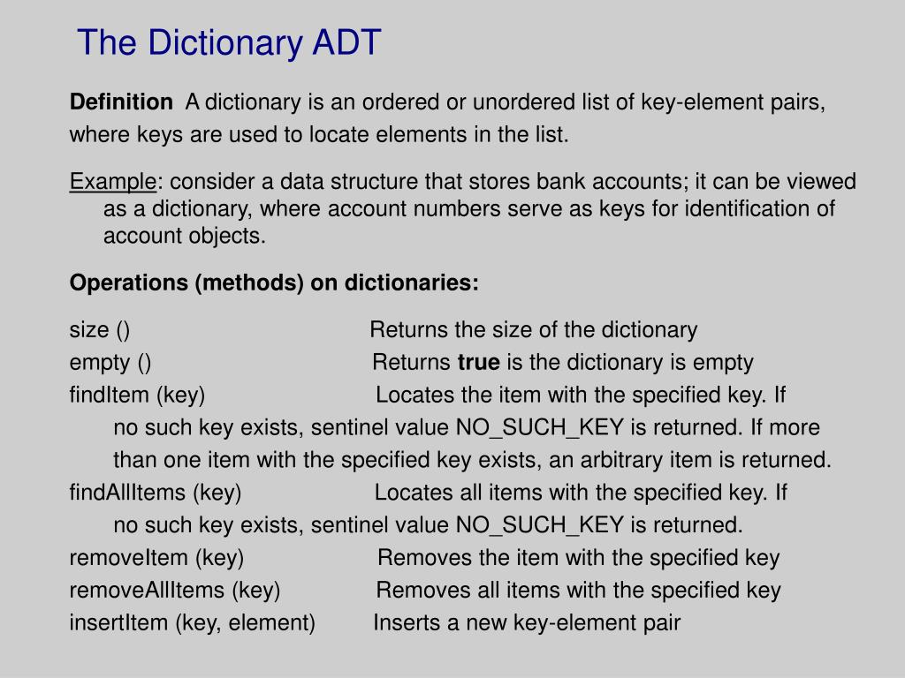
Dictionary ADT

Slide 7
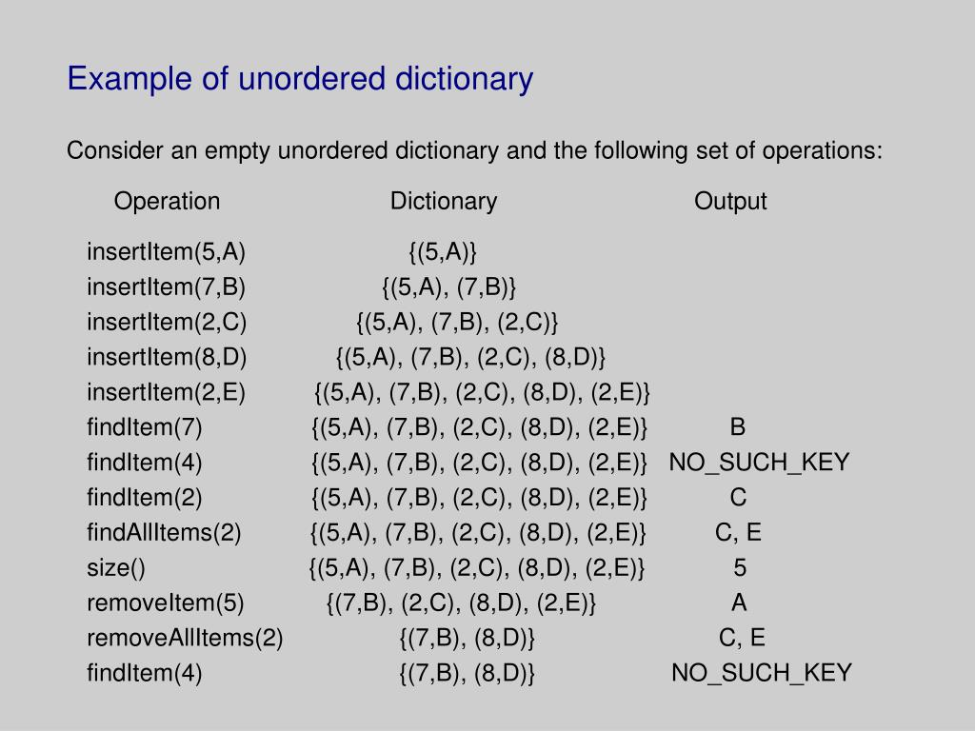

Slide 8
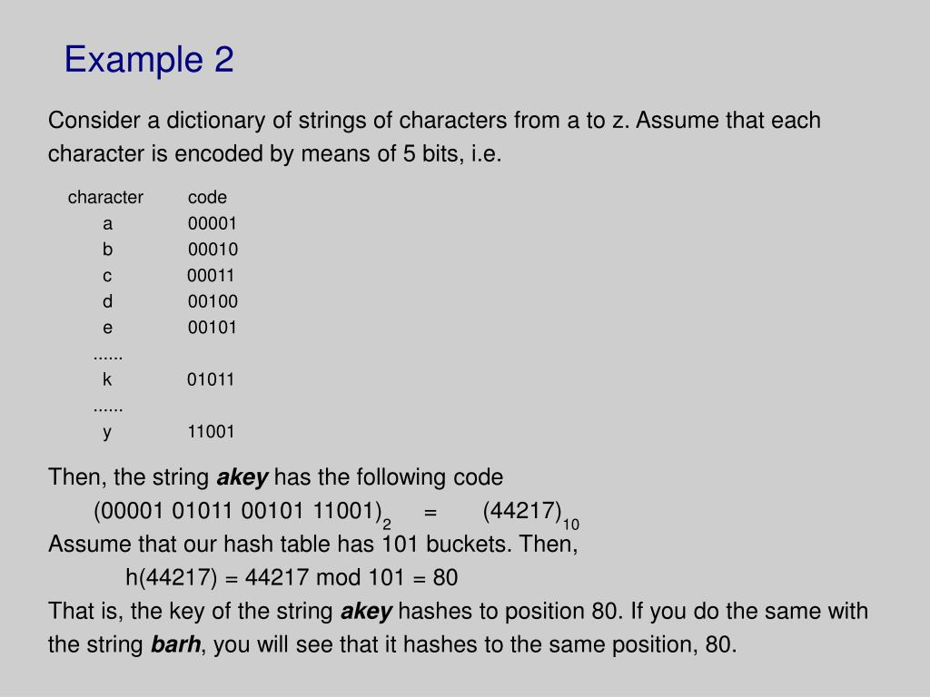

Slide 9
Applications :
In compilers – (as symbol table) to keep track of declared variables/functions/class/keywords, etc.
Online spelling checking.
Game playing programs – to store the moves made.
In browser programs – for caching the web pages.
Security – cryptography in form of hash functions.
Password verifications
Programming-
HashSet and HashMap in Java
Dict in Python

